Slide 1

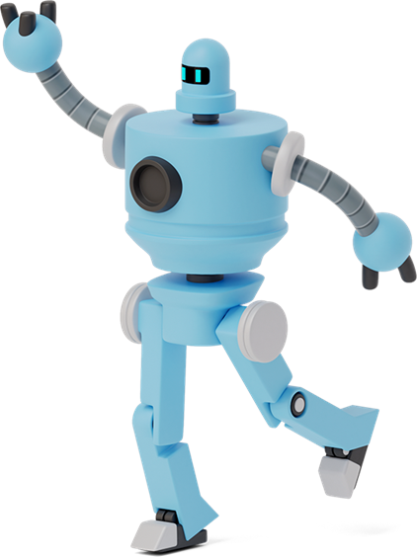
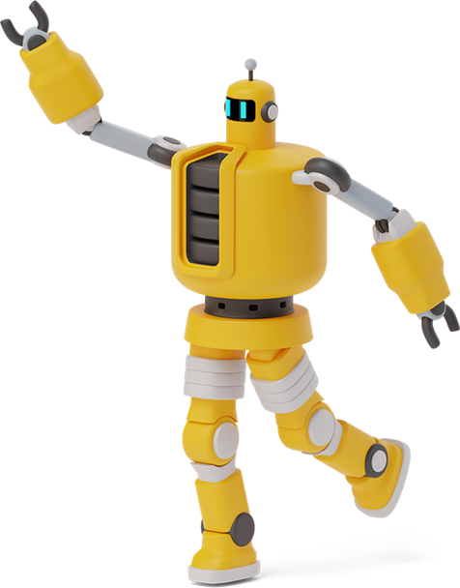
Welcome
EVERYONE

Slide 2

TEAM MEMBERS
Farhana Jaman
2020-1-60-006
Syeda Nafisa Anjum
2019-2-50-011
Jabatun Nessa Nisha
2020-3-60-066
Abdullah Al Rafi
2020-1-80-068
Shahariar Emon Fahim
2020-1-80-020

Slide 3

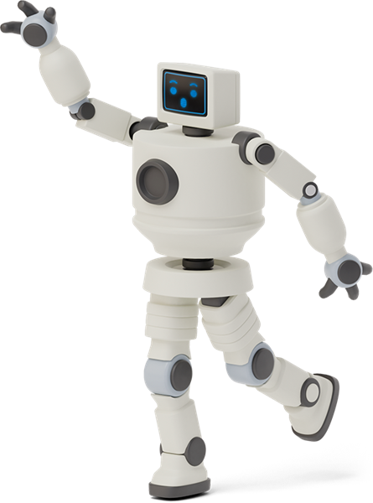
HUMAN VS ROBOT

Slide 4

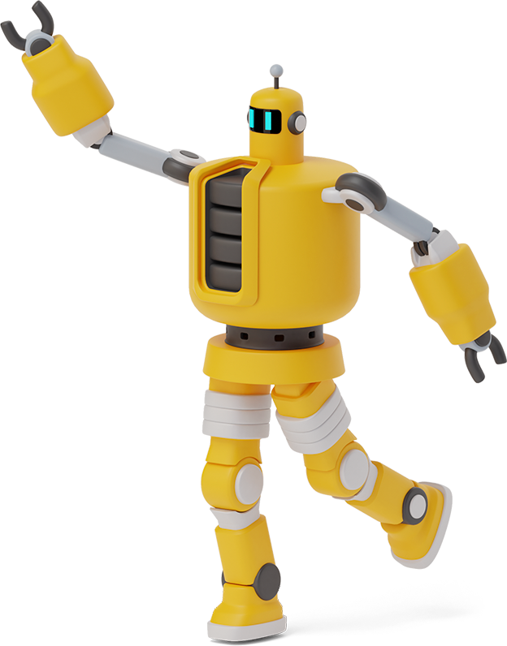
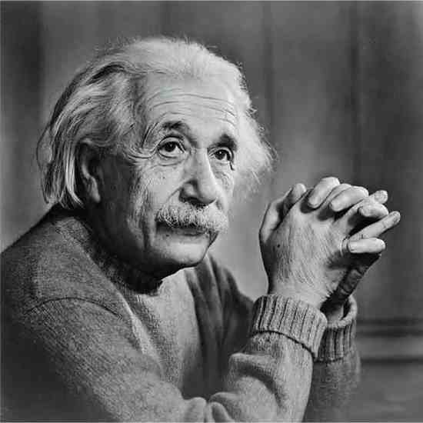
ROBOT
A robot is a machine which is automatically able to perform activities on its own without the aid of external variables.
HUMAN
Humans are organic individuals. They are far more advanced, in the sense that they have a highly developed brain.

Slide 5
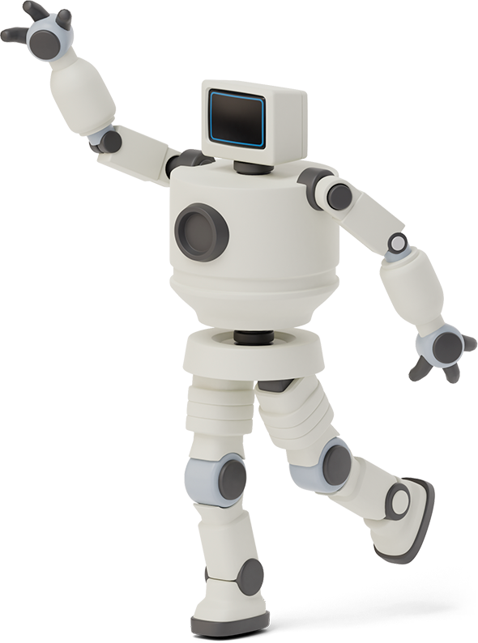


IN 1954, The first digitally operated and programmable robot was invented by George Devol .
IN 1969, Victor Scheinman created the Stanford Arm, recognized as the first electronic computer-controlled robotic arm.
IN 1970, The first mobile robot capable of reasoning about its surroundings, Shakey, by the Stanford Research Institute.
IN 1996, The biomimetic robot RoboTuna was built by doctoral student David Barrett at the Massachusetts Institute of Technology.
IN 1999, Sony introduced the AIBO a robotic dog capable of interacting with humans.
IN 2000, Honda revealed the most advanced result of their humanoid project in 2000, named ASIMO. ASIMO can run, walk, communicate with humans, recognize faces, environment, voices and posture, and interact with its environment.
ON 2017, at the Future Investment Summit in Riyadh, a robot called Sophia was granted Saudi Arabian citizenship, becoming the first robot ever to have a nationality.

Slide 6
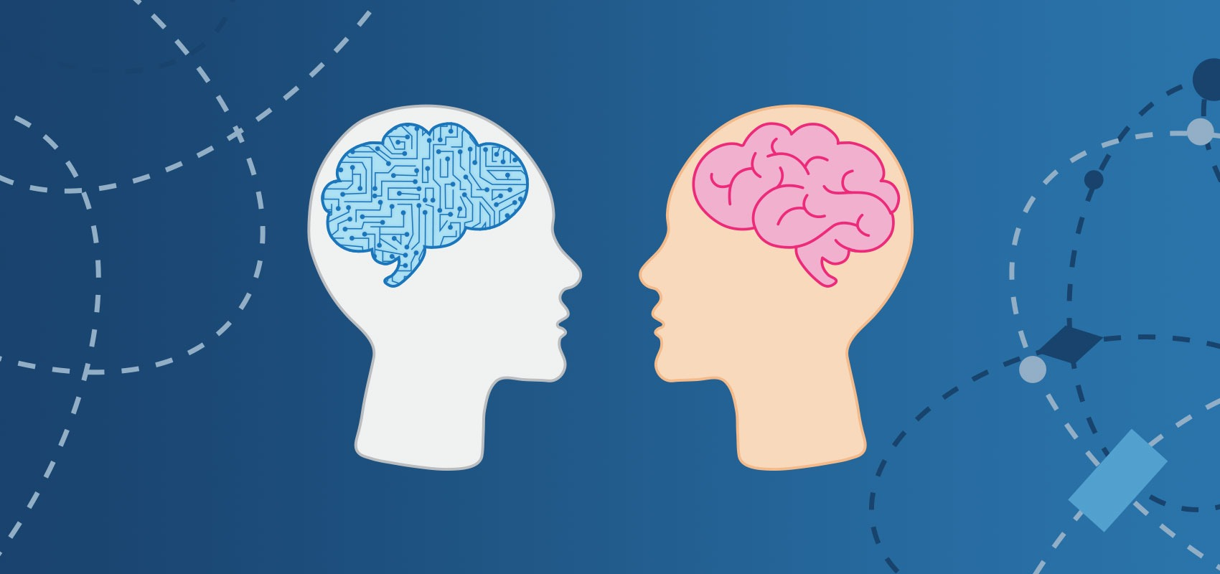
Artificial Intelligence VS. Human Intelligence
Artificial Intelligence is a branch of Data Science that focuses on building smart machines which are capable of performing a wide range of tasks.
Human Intelligence refers to human intellectual capability that allows us to think, learn from different experiences, understand complex concepts, solve mathematical problems, recognize patterns, make inferences and decisions,

Slide 7
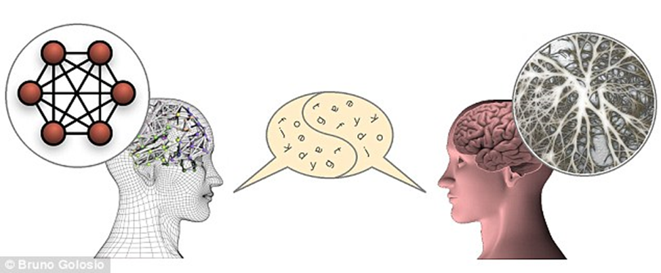
Working of Artificial Intelligence vs working of Human Intelligence: A comparison
Nature: The main difference between natural and artificial intelligence is the process of functionality and the time taken by both of them.
Functioning: Human Intelligence to process and understand the problems and gets accustomed to them. In the case of Artificial Intelligence proper inputs and study, it helps them to provide accurate result in the end.
Learning power: Human Intelligence has a much more powerful thinking capacity than Artificial Intelligence and can have great problem-solving skills depending on the crux of the situation. Artificial Intelligence can learn from data and through continuous training, but they can never achieve the thought process unique to humans.

Slide 8

Human vs Robotic job replacement
Advances in robotics and artificial intelligence are increasingly enabling organizations to replace humans with intelligent machines and algorithms.

Slide 9
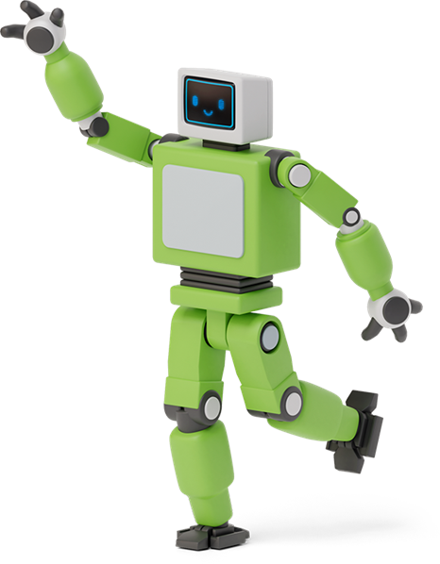
Article And Report On Robots Are Replacing Humans
According to a report by Oxford Economics, the robotics revolution is rapidly accelerating, as fast-paced technological advances in automation, engineering, energy storage, artificial intelligence and machine learning converge. The far-reaching results will transform the capabilities of robots and their ability to take over tasks once carried out by humans.

Slide 10
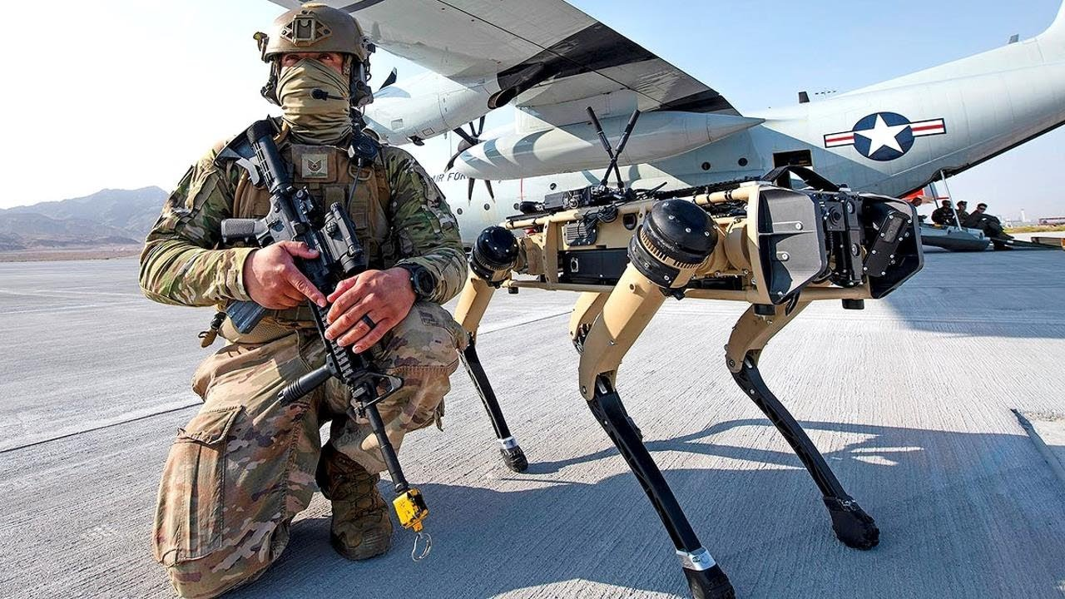
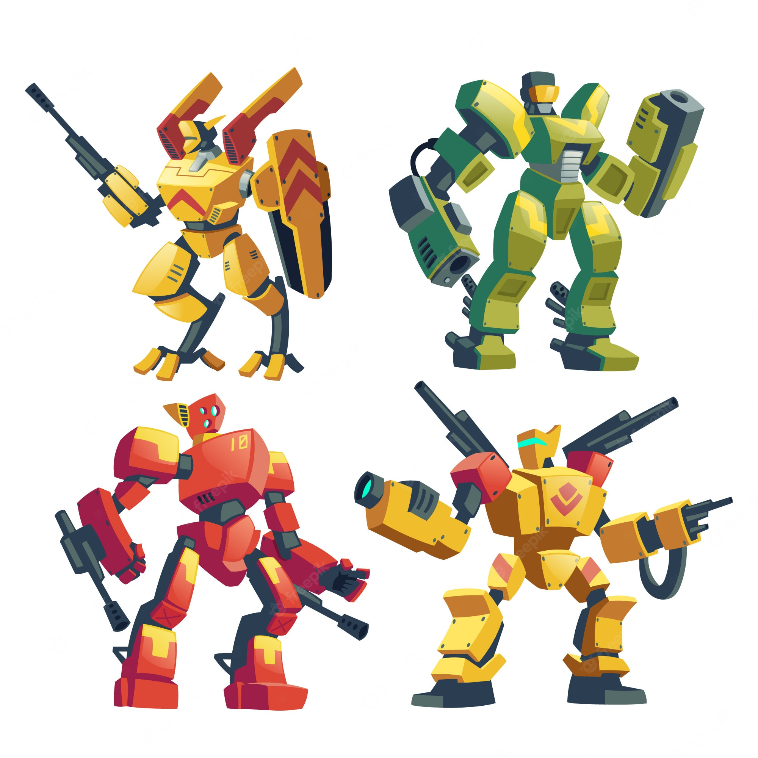
Robots Soldiers vs. Humans Soldiers
Robot soldier are better than human soldiers in some tasks, because technological advances in computer programs. Now it is possible to develop systems which are capable of selecting targets and firing on them without human control. Autonomous weapon system would be able to process data and operate at greater speed than those controlled by humans.

Slide 11
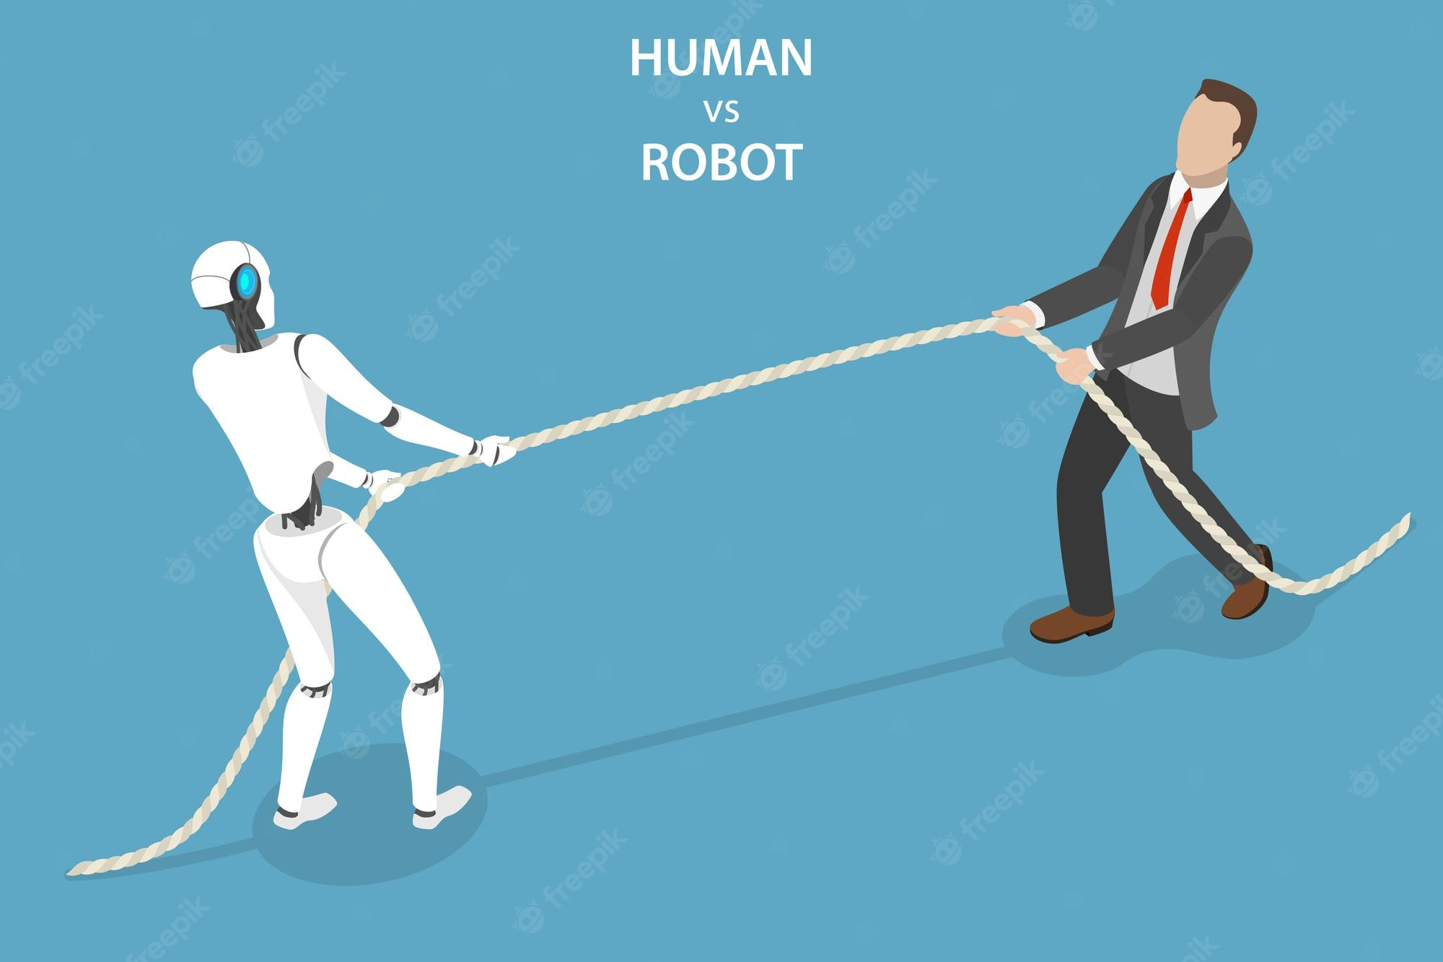
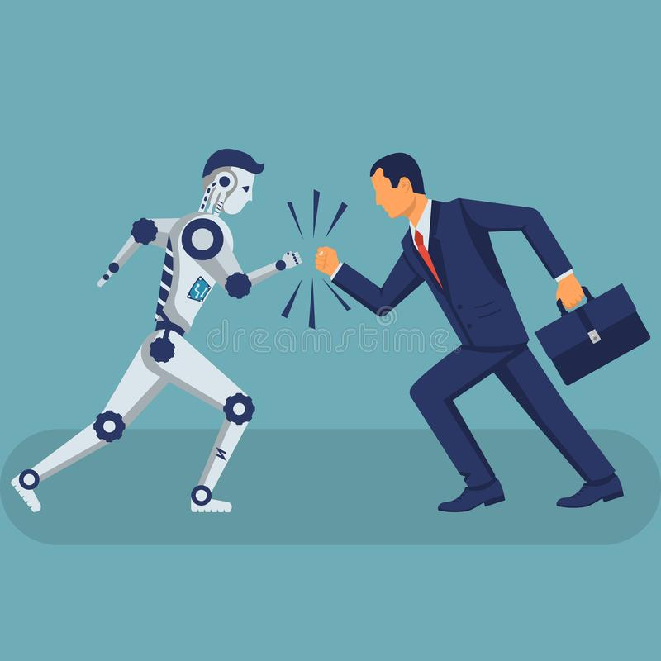
Robots vs Humans War
Who will win?

Slide 12
Robots vs Humans War
We’re just not there yet in terms of technological feasibility or social acceptability.
Robots have greater mobility limitations than soldiers do.
Robots have issues with power supply that need to be resolved first. Most ground robotic platforms can operate from 30 minutes up to a couple hours. Soldiers can carry enough to operate for several days.
There is no instinct. Human beings are clever. A human can literally camouflage and shoot a robot down and it would still have no clue.
So, I think human will win.

Slide 13
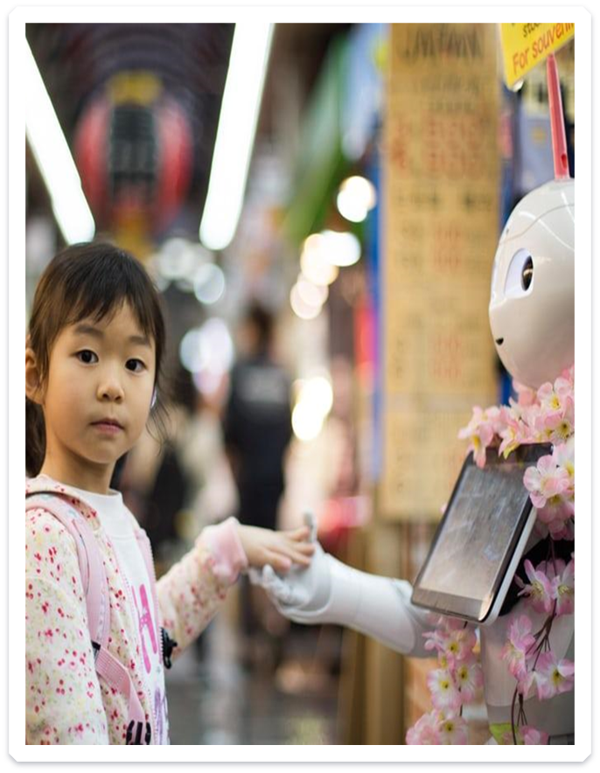
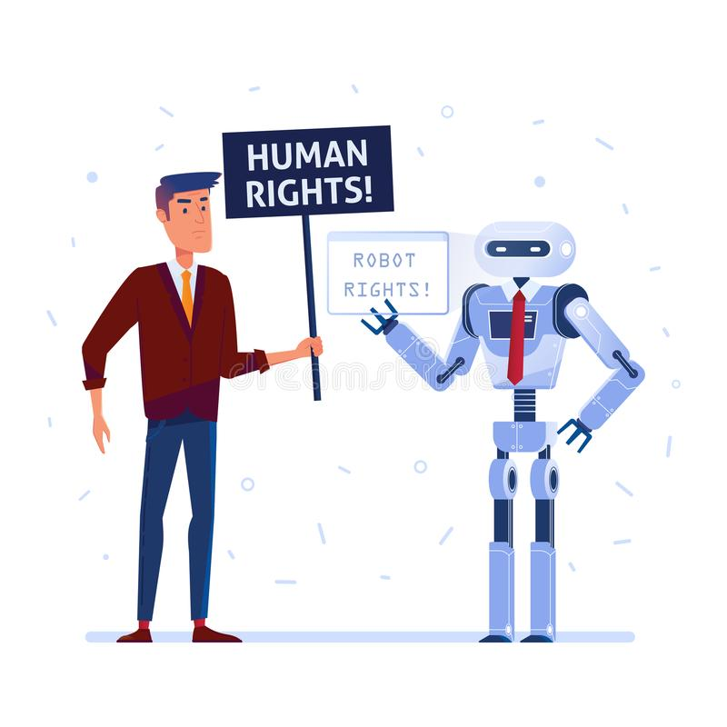
HUMAN RIGHTS VS. ROBOT RIGHTS
Forecasts
Japan continues to be in the vanguard of human robot communication. Japanese citizens are more comfortable sharing living and working environments with robots than with foreign caretakers and migrant workers. These initiatives are paralleled by a growing support among some roboticists and politicians to confer citizenship on robots. Robots are machines, more similar to a car or toaster than to a human. Humans and other living beings with sentient deserve rights; robots don’t, unless we can make them truly indistinguishable from us. After that we have to develop robot right.

Slide 14
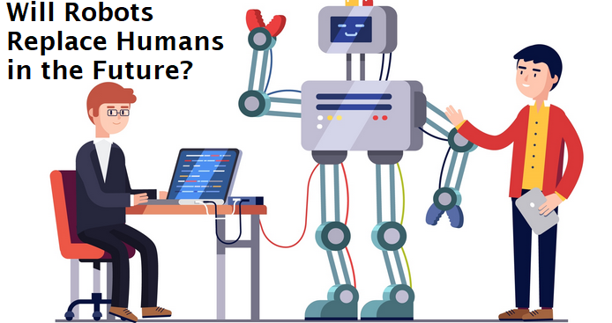
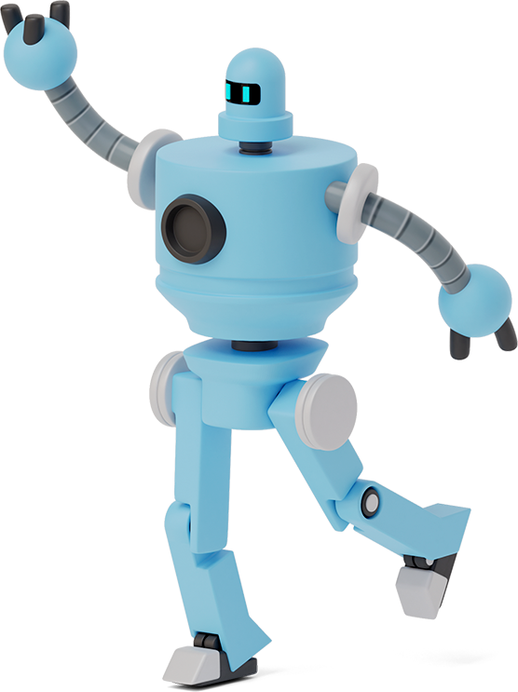
Robots which need some human controls are better because they do no replace completely the human labor. However, some machines and robots will replace humans completely since they need no human input to run. They are just programmed to run without needing any input from human beings.

Slide 15
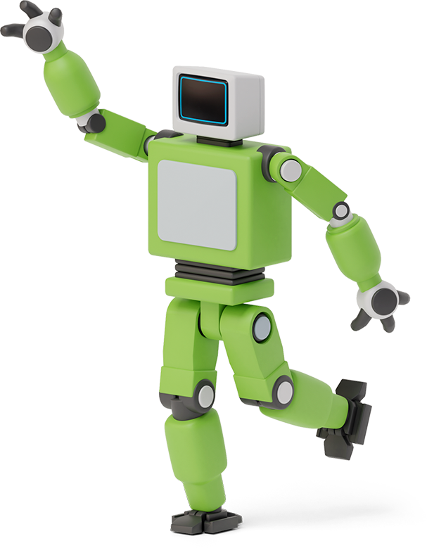
Why Robots Will Never Fully Replace Humans?
1. Robots Don't Understand Irrational Thought
2. Robots Don't Understand Context
3. Robots Don't Understand Customer Service
4. Robots Lack Creative Problem Solving
5. People Prefer to Talk With a Human

Slide 16
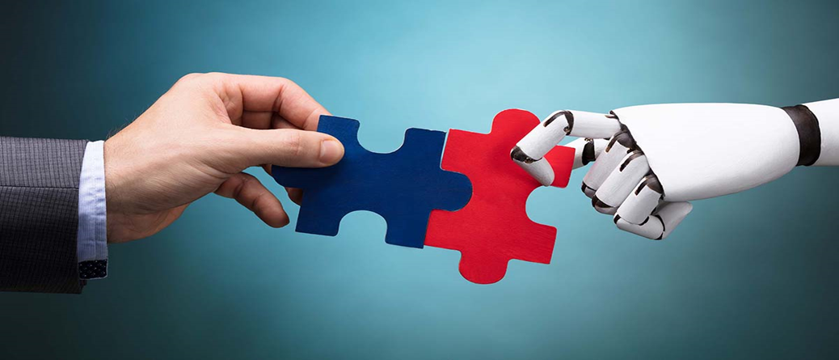
Advantages Of Human And Robot
Human
1. Humans can be skilled in various categories whereas robots are produced for special work purposes.
2. With enough knowledge human can access and use every kind of information but robots can only access digital information.
3. Humans are mandatory to keep the nature alive.
Robots
1. Robots can work in unsafe and harsh environments like warzones, nuclear plants, underwater, space, low air pressure areas etc.
2. Robots don’t have any biological demands like Hunger, Boredom, Social interactions, Rest etc.
3. Robots are faster and more accurate in accomplishing tasks.

Slide 17
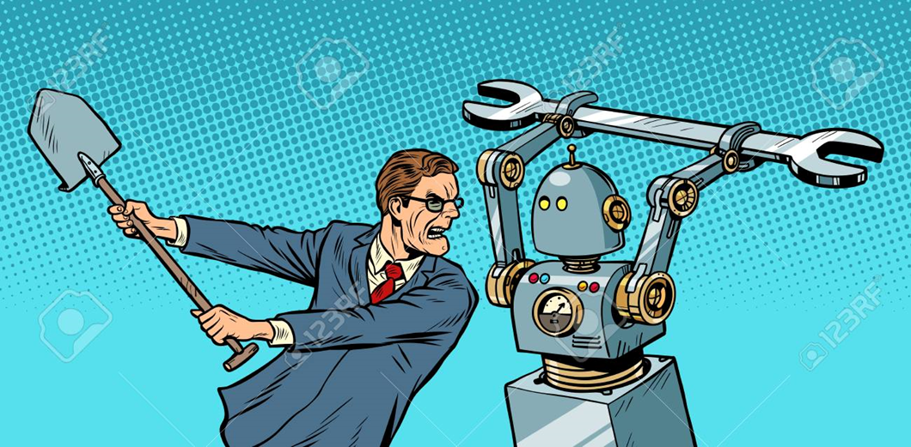
Disadvantages Of Human And Robot
Human
1. Human require biological demands like break, food, social interactions, entertainment etc.
2. Humans are emotional and so some of their decisions are not based on logic.
3. Humans are not eligible to do any kind of work before an age. Moreover, human working ability changes over time.
Robots
1. Without electricity robots are of no use.
2. Robots require adequate and precise information to work. Otherwise disaster can take place.
3. Without proper handling, robots can be harmful for people.

Slide 18
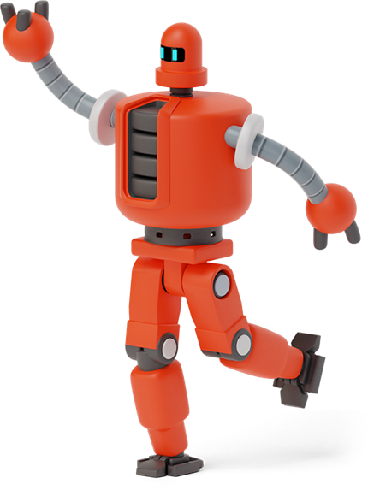
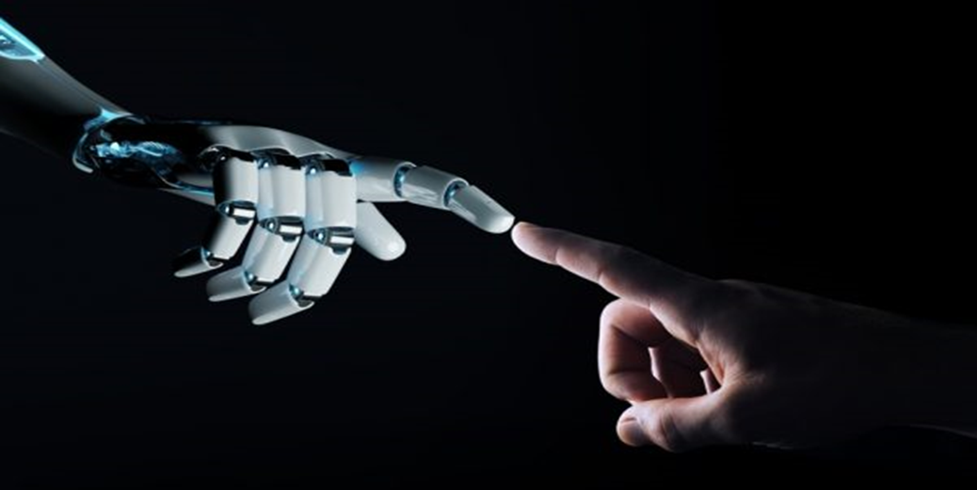
Conclusion
With our research we have come to the point that Human and Robots are becoming inseparable part of human history. In fact, in near future it would be impossible to get regular works done without the help of robots. Moreover, many sectors have started to use robotics including healthcare, manufacturing, and military. So, depending on robots is proving to be positively effective. Therefore, the future of is not versus, it’s Human and Robots.

Slide 19
Reference
1.https://www.futurelearn.com/info/courses/begin-robotics/0/steps/2845
2.https://www.roboticstomorrow.com/story/2018/08/7-advantages-of-robots-in-the-workplace/12342/
3.https://www.quora.com/What-advantages-do-human-workers-have-over-robots
4.https://www.simplilearn.com/future-of-robotics-article#:~:text=Robots%20will%20increase%20economic%20growth,could%20be%20automated%20by%202030.

Slide 20
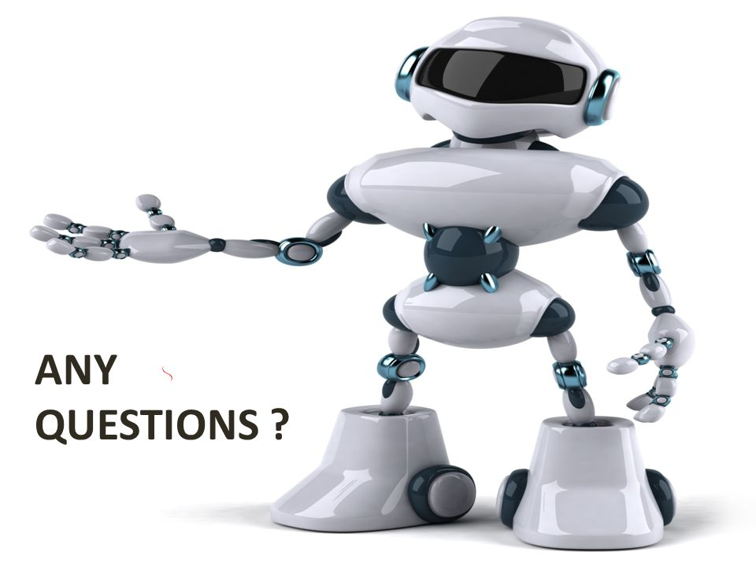

Slide 21

Thanks!

